Slide 1
Diabetes Detection Using Machine Learning Classification Methods
Nour Abdulhadi , Amjed Al-Mousa [1]
Presented by
Team 09
Abanti Chakraborty Shruti ID: 22366034
Ehsanur Rahman Rhythm
Md. Humaion Kabir Mehedi

Slide 2
TABLE OF CONTENTS
01.
Introduction
04.
Results
02.
Experimental Setup
05.
Conclusion and Future Works
Machine Learning Algorithms
03.

Slide 3

Introduction
Number of people living with diabetes more than tripled between 1990 and 2010
90% of all diagnosed cases of diabetes are that of type 2
Predicts the possible presence of diabetes -specifically in females- at an early stage
Focuses on the early detection of type 2 diabetes
Can significantly prevent the progression of the disease and reduce the risk

Slide 4
Process Flowchart
Logistic Regression
LDA
Healthy
Data Preprocessing
Linear SVC
Dataset
SVC
Diabetes
Random Forest
Voting Classifier

Slide 5
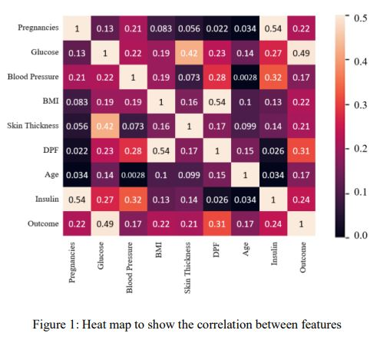
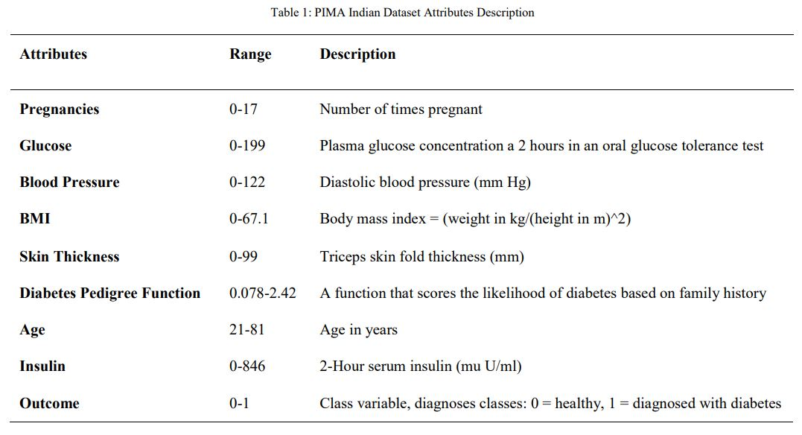
Experimental Setup
Dataset
Data Preprocessing
Pima Indians dataset[2] from the National Institute of Diabetes and Digestive and Kidney Diseases was used
Each of the 768 instances in the dataset has 9 attributes
The missing values were filled with the mean
The dataset was standardized using a standard scaler

Slide 6
Machine Learning Algorithms
Logistic Regression Classifier
Linear Discriminant Analysis (LDA)
Linear Support Vector Machine (SVC)
Polynomial Kernel with SVC
Random Forest Classifier
Voting Classifier

Slide 7
Results
 | Accuracy (%)
Logistic Regression | 80
LDA | 79
Linear SVC | 79
Polynomial kernel SVC | 79
Random Forest Classifier | 82
Voting Classifier | 80

Slide 8
Conclusion
The main objective of this paper was to build a model using supervised learning methods that could help assist doctors in the early detection of diabetes to improve the quality of patient’s lives. Among all models Random Forest Classifier achieved the highest accuracy of 82%.

Slide 9
References
[1] Abdulhadi, N. and Al-Mousa, A., 2021, July. Diabetes detection using machine learning classification methods. In 2021 International Conference on Information Technology (ICIT) (pp. 350-354). IEEE.
[2] L. O. Schulz, P. H. Bennett, E. Ravussin, J. R. Kidd, K. K. Kidd, J. Esparza and M. E. Valencia, "Effects of Traditional and Western Environments on Prevalence of Type 2 Diabetes in Pima Indians in Mexico and the U.S.," Diabetes Care, vol. 29, no. 8, pp. 1866--1871, 2006.

